Slide 1
National Ambulance Handover Protocol
Leah Walsh
National Emergency Medicine Programme
2016

Slide 2
By The End Of This Session You Will:
Understand the need for a standardised handover protocol
Improve the interdisciplinary team dynamics through communication
Understand Patient Care Report Forms
Improve measurement of quantitative data required for Key Performance Indicators
Introduce IMIST AMBO to your departments
Implement IMIST AMBO within your department

Slide 3
Introduction
Notes:
First of all I would like to say a massive thank you to everybody who has been involved in this project. Without all your hard work and dedication, I would not be here presenting to you today and although there are too many names to mention, I would like to say a particular thank you to Dr. Niamh Collins.
Not as much of an introduction as it is a refresher
National ambulance handover protocol was developed to address the need for a standardised approach to ambulance handovers
The aim of the protocol is to:
Improve interdisciplinary communication
Improve handover quality
Provide quantitavtive data
Help monitor KPI’s
But most importantly, patient safety
It has been achieved through joined collaboration with all the relevant bodies, including NAS, PHECC, EMP, HSE and DFB.
The protocol was initially made available in 2013, with training available since this date, but today I hope to provide you with the last few key pieces of information to help you ensure it’s success in your area.

Slide 4
Background
2 Trauma Units in New South Wales monitored ambulance handovers in ED’s
373 staff, and a total of 167 handovers
Key observations noted included:
Increased length of handover time
Repetition of information
Loss of information
Difficulty identifying clear roles
(Iedema & Ball, 2010)
Notes:
An initial study was carried out in two separate trauma units in new south wales in 2010. The study analysed the handover procedure from ambulance staff to emergency department staff. Using video recording and reflection, the researchers observed 373 staff members interactions during the handover process, and looked 167 handovers in total.
This included handovers before and after the implementation of imist ambo which we talk about in a while
During the study, the researchers, and participants noted that a lack of a structured handover resulted in
Increased length of handover time
Repetition of information, with many of the same questions being asked over and over again
Loss of information, where components of the handover got lost in translation, or were not verbally handover
Difficulty in identifying clear roles within the emergency department
Think back to the last time you either transferred a patient, or where in another emergency department. Could you clearly identify where the ambulance handover area was? Unless of course there was a queue of ambulances lined up, or what about identifying the ambulance handover nurse? Until he or she came and introduced themselves, you probably wouldn’t have been able to pick her out. I personally have walked by crews as they look at me and said “sorry lads, it’s not me today it’s whoever”
This is fine for departments who have regular crews and know the staff, but what about the crews who don’t know the department, or the staff or the layout?

Slide 5
Background
Poor communication and transfer of information can result in:
Decreased patient safety
Misdiagnosis or delayed diagnosis
Medication errors
Omission of care
24% of malpractice cases in the USA in 2006 directly related to inadequate handovers
(Shah, Alinier & Pillay, 2016)
Notes:
It’s great looking at the effect of a standardised handover protocol on staff, but that’s not our primary concern is it?
In 2016, researchers looked at the effect of handovers on patient safety.
They noted that the repetition of information and loss of information that we just talked about has a profound effect on patient safety
Additional to this, in area’s where there was no formal standardised handover, there was an increase in misdiagnosis or delayed diagnosis. Has anyone here ever actually sat down and read the PCR, nursing notes, and medical notes, and there’s 3 different variations of the event?
The other thing that was noted was medication errors. How many times have we gone to give paracetamol to a patient, and then gone to check the PCR to see if they were given any?
The other point that was there were often elements of care which were missed due to handover.
We had a patient who presented as a pregnant lady with collapse. On presentation she was fine, vitals stable, ECG was NSR. However, her routine ECG’s with the paramedics showed episodes of asystole lasting a few seconds during her collapsing episodes. The crew were excellent, and were not allowing this lad to go anywhere other than resus and their handover was excellent. I know that’s an extreme case, but how often do we take handover and wonder afterwards if they said the patient did or didn’t lose consciousness. Or did they say the patient took 5 Xanax or 50, and what was the strength? How many times do we try to guess what may have been handed over, and then try to look at the carbon copy of the PCR that we can’t read?
Although we know that all of these elements occur as a result of handover, its only when you see that 24% of malpractice cases in America where the result of inadequate handovers, does it really hit home. We never intend to make a patient vulnerable or decrease their safety, but if we continue to handover in the way that we are now, that is what will happen.
We want to say it doesn’t happen, but the reality is that at the minute it is happening, but we change it, but it’s up to us to do that.
What we’re going to do now is a quick role play. Don’t worry…I know that your all a very shy crowd, so two girls from Drogheda have kindly agreed to do the role play. The two girls are going to handover a patient the only way they know how, because like many people here I’m sure, they haven’t done the IMIST AMBO training yet.

Slide 6
Clinical Handover
“Clinical Handover refers to the transfer of information from one health care provider to another when a patient has either a change of location of care, and/or when the care of or responsibility for that patient shifts from one provider to another”
(Pre Hospital Emergency Care Council, 2013)
Notes:
So a clinical handover is defined as, but in order to handover proficiently, we need to be able to communicate. Now I know we’ve all done the theory of communication, but its only when you look at in close detail can you see where it is that we’re going wrong

Slide 7
Interdisciplinary Communication
Communication has been defined as:
“…an interpersonal activity involving the transmission of messages by a source to a receiver for the purpose of influencing the receiver’s behaviour”
(Miller & Nicholson, 1976 cited by Arnold & Undermann Boggs 2003, pg 17)
Notes:
So in order for communication to occur, we need a messenger and a receiver

Slide 8
Components of Communication
Messenger (Paramedic):
Verbal
Non- verbal
Receiver (Nurse or Medical):
Decodes
Open & active listening
(Arnold & Undermann Boggs, 2003)
Notes:
Hands over the patient using both verbal and non-verbal cues
As the receiver we need to able to decode both the verbal and non verbal cues
To do this, we need to review what it is that we perceive to be open and active listening
So does anyone know the components of communication?

Slide 9
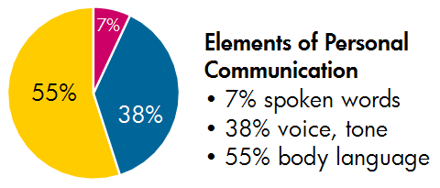
Verbal –vs- Non Verbal Communication
(Communication is Oxygen, 2016)
Notes:
So communication is simple, we have 3 components:
Spoken word
Voice & tone
and body language
So how much of the message are we actually missing out on during handover?

Slide 10
Do Actions Speak Louder Than Words?
93% of the conversation
Requires active listening
This involves:
Facial expression
Eye movements and direct eye contact
Body movement
Gestures (Arnold & Undermann Boggs, 2003)
Notes:
Theoretically, up to 93% of the conversation is going to be missed if we continue to handover in the manner that we saw the two girls handing over.
If we look at what happened during that role play, we will notice that while Aoife was handing over the patient to Grace, Grace was focused on the task, and the patient.
There was very little eye contact, as Grace’s main focus was recording the vital signs
While she tried to acknowledge Aoife’s handover, she missed non-verbal message.. In that Sarah was very well, and did not require a trolley
In order for Grace to pick up on the non-verbal message she needs to demonstrate active listening skills:
Therefore she needs to be able to see Aoife
Watch her facial expression which showed an element of frustration
If she looked at Aoife and made eye contact with Aoife, she may have gotten the message that perhaps Aoife wanted to speak to her 1 on 1 away from the patient
To do this requires undivided attention, an across the room observation will tell us that Sarah was stable, and therefore did not require immediate observations or interventions
Therefore the nurse needs to adopt the handsoff eyes on approach to patient handover.

Slide 11
Clinical Handover
Hands off, Eyes on
Notes:
Hands off, eyes on means giving the ambulance crew undivided attention and engaging in 100% of the conversation versus 93% of the conversation. Ultimately this will help receive a better handover and help you to care for the patient more efficiently.

Slide 12
It’s Just A Mnemonic
ISBAR
METHANE
IMIST AMBO
ABCDE
ASHICE
Notes:
To help structure the handover, and reduce the time spent in handing over, the hse, nas, dfb, phecc and emp have found a very simple Mnemonic for you to use:
It’s the exact same as every other pneumonic we use like isbar, methane, ashice or abcde
Its called IMIST AMBO
Don’t worry, we don’t expect you to know it off the top of you head, that’s why we’ve given you all the notepads with it written on it

Slide 13
Notes:
IMIST AMBO was initially developed by an intensive care paramedic called Jacinta Young
Jacinta practiced in NSW and developed the pneumonic to help solve difficulties encountered in handovers
This was then implemented by NSW
It is broken into two components and allows for a break for questions
It is to be used in all scenario’s, i.e. both the stable and unstable patient

Slide 14
What is IMIST AMBO
National Ambulance Handover Protocol
“Hands off” approach
90 seconds
Split into two components
Notes:
This is the national ambulance handover protocol that will be used national for all ambulance handovers
In order for it to be effect, I cannot stress enough how important it is to ensure we adhere to the eyes on hands off approach
Research from new south wales has shown that this approach is much quicker and reduced times from 230 seconds to 90 seconds
But in order for it to be effective, we must allow for it to be split into two separate componenets

Slide 15
Notes:
The first part is IMIST
Identification of patient or introduction of patient
Mechanism of injury or medical complaint
Injuries or information related to the complaint
Signs (vital signs)
Treatment and trends
At this stage the paramedic allows 20 – 3- seconds for questions

Slide 16
Notes:
The second part is the AMBO component
Allergies
Medication
Background
Other information
Again, questions can be asked at this stage.
Once this is complete, the patient is verbally handed over, but not physically
We’ll talk about the significance of this in a few

Slide 17
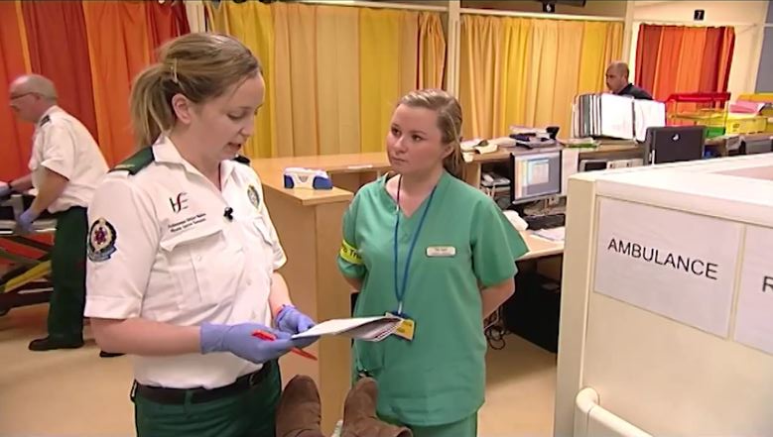
Receiving handover: Stable Patient
Clearly sign posted
Confidential area
Ambulance triage nurse clearly identified
Infection control precautions
Notes:
So in your department you need to clearly identify an ambulance reception area
Each ED department will get a pack on the way out today, and there are signs in the pack
The area must be one that allows patient confidentiality, and therefore not on a corridor with other patients
The ambulance triage nurse MUST be clearly identifiable, there are so many ways of doing this including a different coloured lanyard, or an arm band, or a board with the nurses name. It os up to each unit to decide how they will identify the ambulance triage nurse
Additional to this, there must be infection control precautions readily available, such as PPE, alcohol hand gel, sinks.
We know that sinks at an ambulance handover area is not feasible for many departments, so perhaps you can advise ambulance staff on the nearest handwashing facilities.

Slide 18
Receiving Handover: Stable Patient
Pause for questions between IMIST and AMBO
Additional information given at the end of AMBO if required
Patient moved into ED care area
Complete the PCR
Notes:
So as the ambulance triage nurse receiving care of a stable patient you introduce yourself to the ambulance crew
Allow the crew to hand over the patient and ONLY ask questions during the pauses
It is SO important that you do not interrupt the crew during their handover
Once the verbal handover is complete, you need to move the patient to the appropriate area, so either the waiting room, a chair or a trolley
Once the patient is moved from the ambulance equipment into the hospital area, they are then considered your patient
You need to note this time, and in agreement with the ambulance crew, allow the ambulance crew to document this on their PCR.
That means that the patient IS NOT handed over and is under the care of the AMBULNCE CREW until they are moved to an appropriate space in the ED
However, there are circumstances where joint care can occur
These include:
Analgesia
Anti-emetics

Slide 19
Completing a Patient Care Report Form (PCR)
Notes:
So when you are completing the PCR, you need to be aware of a few things. The first one is that there are 2 types of PCR’s
This one is a PHECC PCR and is used by DFB
The second one is a NAS PCR and used NAS (HSE)
Both forms have an area that is clearly labelled at handover.
This is the area that both you and the ambulance crew need to agree on a time.
As this document belongs to the pre-hospital staff, they are the ones that write the time in

Slide 20
National Ambulance Service PCR

Slide 21
Recording of Data
IT systems should record:
Arrival at destination
Handover time
Provides quantitative data
Auditing of KPI’s
Notes:
So as I’ve said once or twice, until full handover is complete, the patient is NOT and ED patient
That means that they should not be logged onto the system until full handover is complete
From tomorrow on, we will ask that clerical staff do not register patient’s until a signed PCR is given to you. That also means not asking families to register patients while you triage them
The other part is making sure that the times put into the IT systems should be accurate and record the arrival at destination time and the handover time (where possible)
This is the vital component to allow us to audit the ambulance handover KPI

Slide 22
Clerical: We Need Your Help
Notes:
Clerical, this is where we ask for your help.
I understand that as this protocol is Implemented, you will find it difficult, as we need you to make sure you do not register the patient until they have been fully handed over
And for the next few weeks you will be the one’s telling family that you’ve to wait for the nurse to triage them, or telling the ambulance crews that you cant register the patient until they are handed over.
I know how difficult this might be, but we need your help to make this work
Also, it is going to change how you register the patient’s (slightly).
So depending on which system you use will depend on where you input your data

Slide 23
Clerical: We Need Your Help

Slide 24
Clerical: We Need Your Help

Slide 25
Completing a Patient Care Report Form (PCR)
Additional Information is inserted by ambulance staff
This can include reason for delay:
Ongoing clinical care
Delay in verbal handover
Must be signed by receiving nursing staff
X

Slide 26
Completing A NAS PCR Form
X

Slide 27
Receiving Handover: Unstable Patient
Notes:
If any of you have looked at the protocol, you will have noticed that it talks about pre-alert
At present, ambulance crews will pre-alert hospital staff if they feel it is necessary
To pre-alert us, the ambulance crew will contact their control who will then contact the department either by radio or emergency phone.
The handover will be the same for all patients and will be given in the form of ashice
ASHICE is at the back of the page in the notepad given to you
So then what do you do when you get a pre-alert

Slide 28
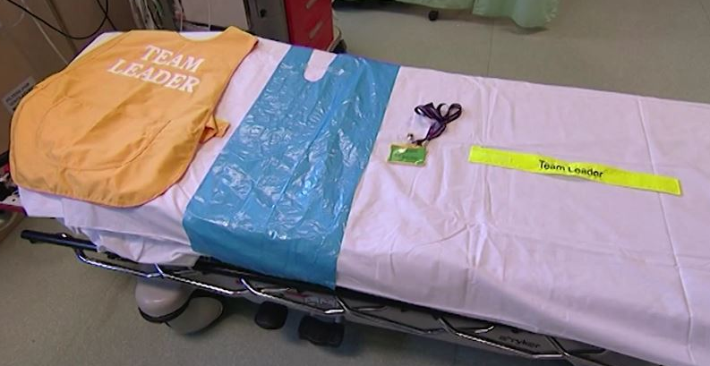
Receiving Handover: Unstable Patient
Organise resus as required
Clearly identify team lead
Allocate roles
Request assistance from
clerical staff
Notes:
Ok, so we all know that we need to organise our resus room and our team when preparing for a patient, but how many of us clearly define roles of staff members on presentation?
How many of us inform clerical that we are expecting a patient and ask for help?
How many of us allocate a nurse to write down the handover?
These are the things that we need to be doing
Medical staff need to decide who is the team lead and clearly identify the tam lead
Like the ambulance triage nurse, the team lead needs to be visibly identifiable, and again, this is up to each department.

Slide 29
Receiving Handover: Unstable Patient
Hands off, Eyes on where appropriate
Receive IMIST handover on the ambulance stretcher
Only team lead and pre-hospital lead to communicate
Patient to move to hospital trolley
Receive full IMIST AMBO at this stage
Notes:
Again, when receiving handover of the unstable patient, we need to observe a hands off, eyes on approach, where appropriate
This means that’s if CPR is ongoing, the treatment continues, but the team lead and ambulance member handing over the patient DO NOT get involved
IMIST handover is given while the patient is on the ambulance stretcher and the patient is then moved onto the trolley
It is extremely important that while treatment continues, it is done in a quiet manner to allow handover to be given
Once the patient is on the ambulance stretcher, a full IMIST AMBO handover is given

Slide 30
Allocation of Tasks: Clerical
Notes:
Clerical, we need you again. It is advised that clerical come to the unstable patient as they arrive to get the patient details and start logging the patient onto the system.
This will help avoid delays in logging the patient on the system, as the ambulance crew may not be in a position to give you the PCR for a delayed period of time due to ongoing care

Slide 31
Allocation of Tasks: Nursing
Notes:
Similar to a paediatric call where someone fills out a WETFLAG on a patient, we need someone to fill out the IMIST AMBO handover on the unstable patient
Each department will be provided with wipable posters which can be hung in resus and can be filled out as handover is been given. It helps to communicate the handover to all members of the team
Now that we’ve looked at how to handover using the IMIST AMBO, I’m going to ask the girls to hand over a different patient and see if it makes a difference

Slide 32
Conclusion
Lack of a standardised handover inhibits transfer of information and directly affects patient safety
Improve interdisciplinary communication: non-verbal communication
Hands off, eyes on approach
Accurate documentation and monitoring of key performance indicators

Slide 33
Conclusion
IMIST AMBO handover of stable patient:
Clear identification of ambulance handover area and ambulance handover staff
Handover is only complete when patient is physically handed over
IMIST AMBO handover of unstable patient:
Clear identification of team lead
Structured handover
Clerical input
IMIST followed by IMIST AMBO

Slide 34
We Are Now Live
National Ambulance Handover Protocol will be Live from
Wednesday 27th July 2016
Notes:
Ok, so that’s IMIST AMBO
It is a simple technique that yields massive improvement to care for our patients
However, it will only be effective if we drive it
So we are asking that from tomorrow on, you start implementing it into your departments and make sure all your staff are trained
Its up to you’s now to become the leaders

Slide 35
Notes:
We know that what we are doing currently is not as effective as it could be
And if we don’t change it, nothing will change
So it is up to YOU to persist with this protocol and make the change

Slide 37
References
Arnold E. & Undermann Boggs K. (2003) Interpersonal Relationships: Professional Communication Skills for Nurses. 4th Ed. Saunders: Missouri.
Communication is Oxygen (2016). Available online at http://communicationisoxygen.weebly.com/uploads/4/3/7/2/43721101/5015308_orig.png. Accessed 21st July 2016.
Iedema, R. & Ball, C. (2010) NSW Ambulance/Emergency Department Handover Project Report. Sydney: NSW Health & UTS Centre for Health Communication.
Shah, Y., Alinier, G., & Pillay, Y. (2016). Clinical handover between paramedics and emergency department staff: SBAR and IMIST-AMBO acronyms. International Paramedic Practice, 6(2), pg 37-44.

